Slide 1
Employee Data Analysis using Excel
STUDENT NAME: KANISHKA K
REGISTER NO: 312209577/asunm1353312209577
DEPARTMENT: B.COM GENERAL
COLLEGE: ANNA ADARSH COLLEGE FOR WOMEN

Slide 2
PROJECT TITLE
Employee Performance Analysis using Excel

Slide 3


AGENDA
Problem Statement
Project Overview
End Users
Our Solution and Proposition
Dataset Description
Modelling Approach
Results and Discussion
Conclusion
3/21/2024 Annual Review

Slide 4

PROBLEM STATEMENT 1. Improve employee retention and recruitment strategies. 2. Optimize workforce planning and resource allocation. 3. Enhance training programs and employee development initiatives.

Slide 5

PROJECT OVERVIEW
.A performance evaluation conclusion should briefly summarize a person’s performance during the review period, highlighting their key strengths and something they can improve upon:
Objectives and goals
Time management and organization
Communication
Areas of improvement

Slide 6

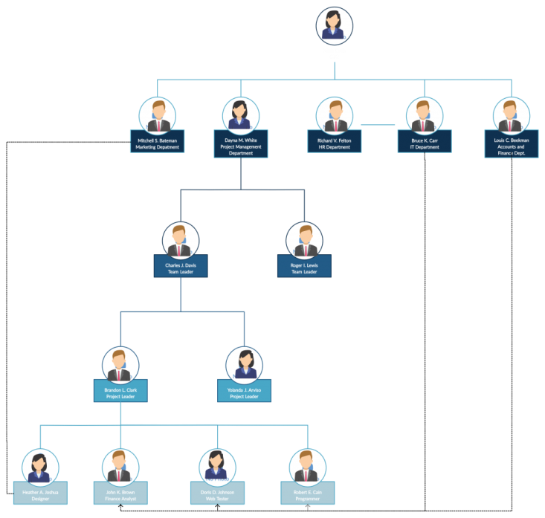

WHO ARE THE END USERS? The employees Managers Peers Customers and Clients Team leaders Organisations

Slide 7

OUR SOLUTION AND ITS VALUE PROPOSITION Conditional formatting: For highlighting the missing value. Filtering: Removing and filtering the missing values. Formula: For calculating the employee’s performance. Pivot table: For summary. Graph: Data visualization.

Slide 8
Dataset Description Employee data set is taken from IBM dashboard. Details taken 11 features out of 22 features. They are: Employee ID- Numerical value First name- Text Last name- Text Start date- Numerical value and Text Exit date- Numerical value and Text Business unit- Text Employee classification type- Text Gender- Category type Performance score- Text Current employee rating- Numerical value

Slide 9

THE "WOW" IN OUR SOLUTION =IFS(Z8>=5,”VERYHIGH”,Z8>=4,”HIGH”,Z8>=3,”MED”,TRUE,”LOW”) USED FOR CALACULATING THE CURRENT EMPLOYEE RATING
3/21/2024 Annual Review
9

Slide 10
MODELLING
Data collection- Collected the data collection from IBM dashboard
Features collection- Features was taken 11 out of 22 from the data set
Features selection- The features which are required for the employee performance
Data cleaning- Identifying the missing values and filtering it
Calculation of performance level- It was calculated based on the current employee rating
Summary- Pivot table= Clicked insert option and pivot table option.
Graph= Went to the insert and click on the chart and clicked to show the table in the graph
Pie chart= Same procedure as click the insert in menu bar and again clicked the shapes to show the pie chart
10

Slide 11
RESULTS
11

Slide 12
RESULTS
Result for high performance level

Slide 13
Conclusion Our analysis of employee performance using excel revealed key trends in productivity, areas for improvement, and top performers across department. By identifying high-performing individuals and teams , management can focus on best practices to enhance overall productivity and address performance gaps effectively. By leveraging data-driven insights from this analysis, we can create a more efficient and motivated workforce, driving success for both employees and organization.

